Slide 1
Shared Licenses for Network Zone Consortia
Yoel Kortick
Senior Librarian

Slide 2

Agenda
Introduction
Adding a Centrally Managed License in the NZ
Manually distributing the shared license to Member Institutions
Viewing the shared license in the Member Institution
Automatically distributing the shared license to Member Institutions

Slide 3
Introduction

Slide 4
Introduction
Alma allows for global licenses to be shared between the Network Zone (NZ) of a consortium and member institutions.
Member institutions can use both the shared licenses as well as licenses they add locally.
Note: throughout this presentation when we use the term “NZ” we mean “Network Zone”

Slide 5
Introduction
For more information about the use of shared licenses see “Centrally Managed Licenses for Electronic Resources in a Network Zone” at:
https://knowledge.exlibrisgroup.com/Alma/Product_Documentation/010Alma_Online_Help_(English)/100Collaborative_Networks/06_Acquisitions_in_Consortia/01_Central_License_Negotiation

Slide 6
Introduction
In the example here we have a network zone and three member institutions:
Member / Network | Name | Inst. Code
Network | Ex Libris University Consortium | EXLDEMO2_INST
Member | Alma University | EXLDEV1_INST
Member | Open University | EXLDEMO3_INST
Member | University of Knowledge | EXLDEMO1_INST

Slide 7

Introduction
Network Zone
Ex Libris University Consortium
Member Institution
Alma University
Member Institution
Open University
Member Institution
University of Knowledge

Slide 8
Adding a Centrally Managed License in the NZ

Slide 9
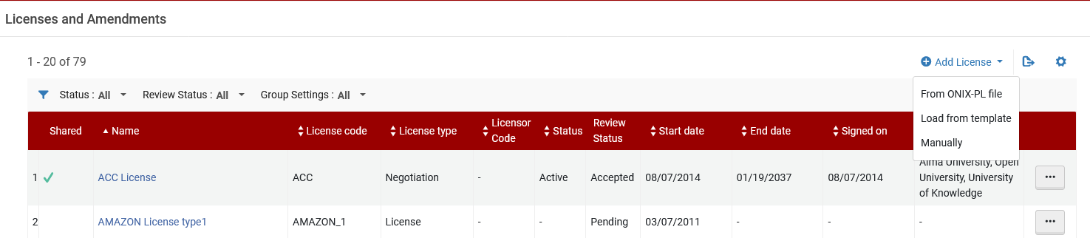
Adding a Centrally Managed License in the NZ
We will now add a Centrally Managed License in the NZ. We do as follows:
Log in to the Network Zone.
Access the licenses at “Acquisitions > Acquisitions Infrastructure > Licenses”
Click “Add License” (in our case we will manually add a license)

Slide 10
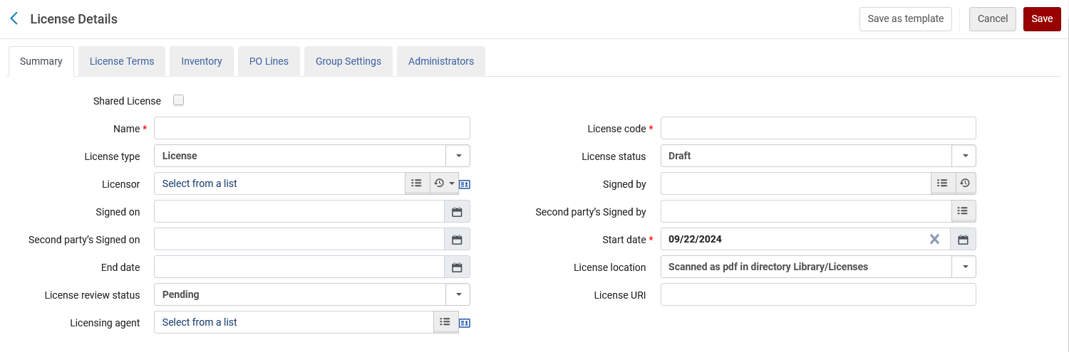
Adding a Centrally Managed License in the NZ
In the “Summary” tab choose “Shared License”
We will now check “Shared License”
Note that we are now creating a “License” (and not a “Negotiation”)

Slide 11
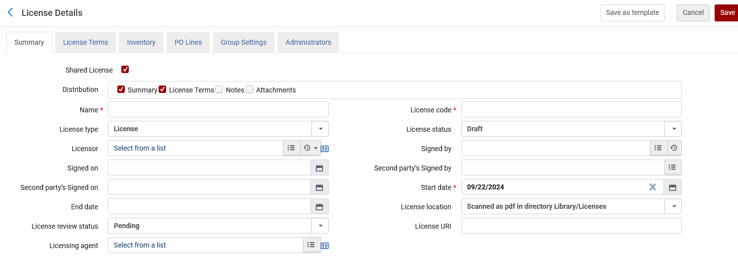
Adding a Centrally Managed License in the NZ
Note that after checking “Shared License” we have additional values we can check to determine which attributes of the license will be shared (distributed to the Member Institutions as part of the license)
We will share the license “Summary” and “License Terms”

Slide 12
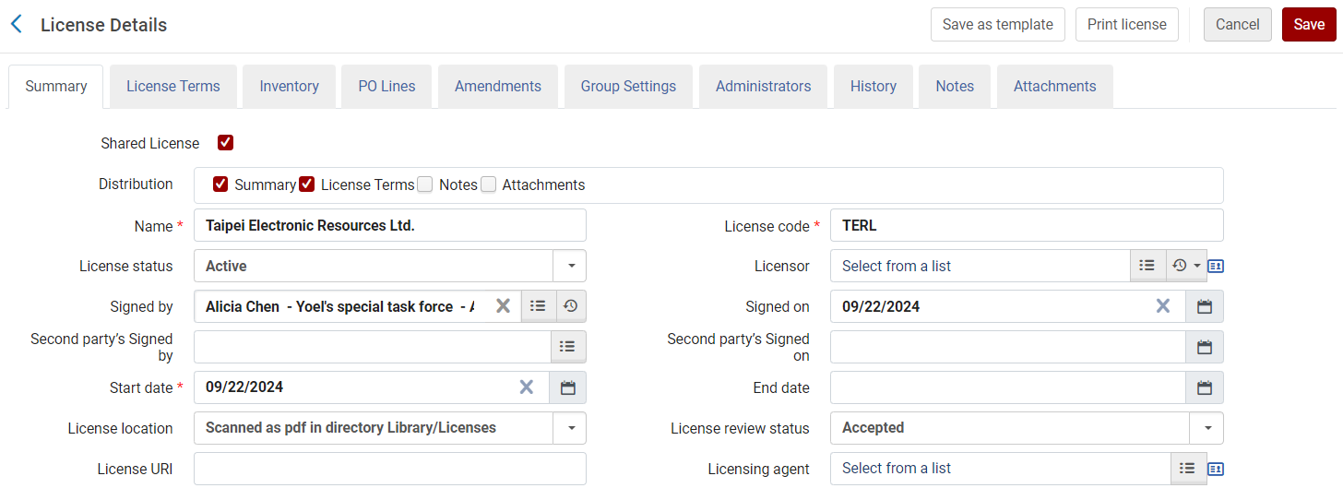
Adding a Centrally Managed License in the NZ
Here is the Summary tab of the license
The license is named “Taipei Electronic Resources Ltd.”

Slide 13
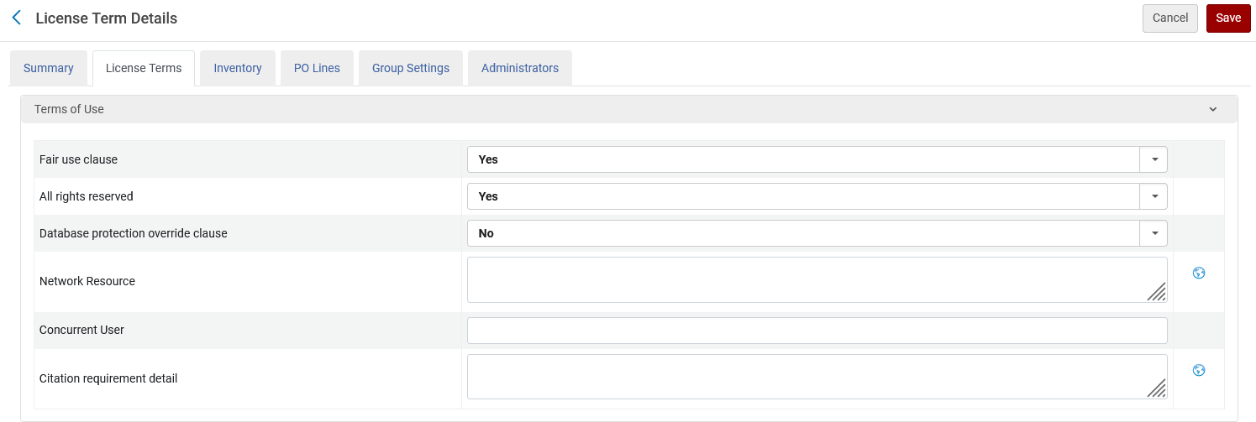
Adding a Centrally Managed License in the NZ
Here is the License Terms tab of the license

Slide 14
Adding a Centrally Managed License in the NZ
Save the license

Slide 15
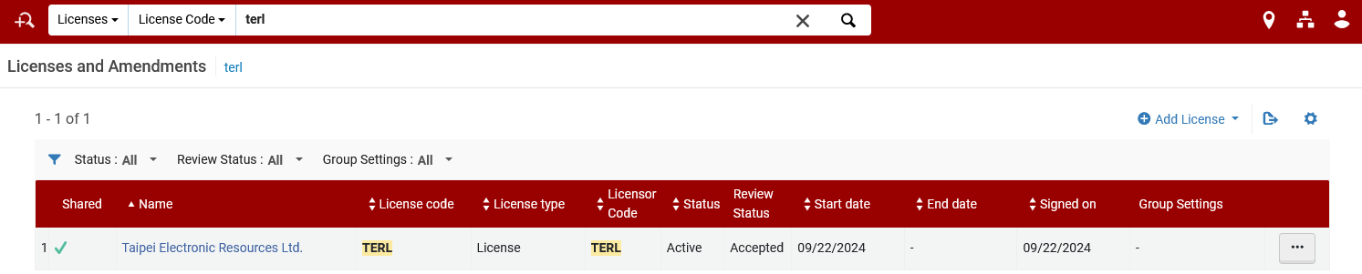
Adding a Centrally Managed License in the NZ
The license is saved in the NZ

Slide 16
Distributing the shared license to Member Institutions

Slide 17
Distributing the shared license to Member Institutions
To manually distribute the license:
On the Licenses and Amendments page (Acquisitions > Acquisitions Infrastructure > Licenses), select Distribute to member in the row actions list.
  This option only appears on the Network Zone for centrally managed licenses that have an Active status. After clicking “distribute to member” a list of member institutions appears.
Select the members to which the license should be distributed.
Select Submit and select Confirm in the confirmation dialog box.
  The “Distribute network Acquisition changes to members” job runs.

Slide 18
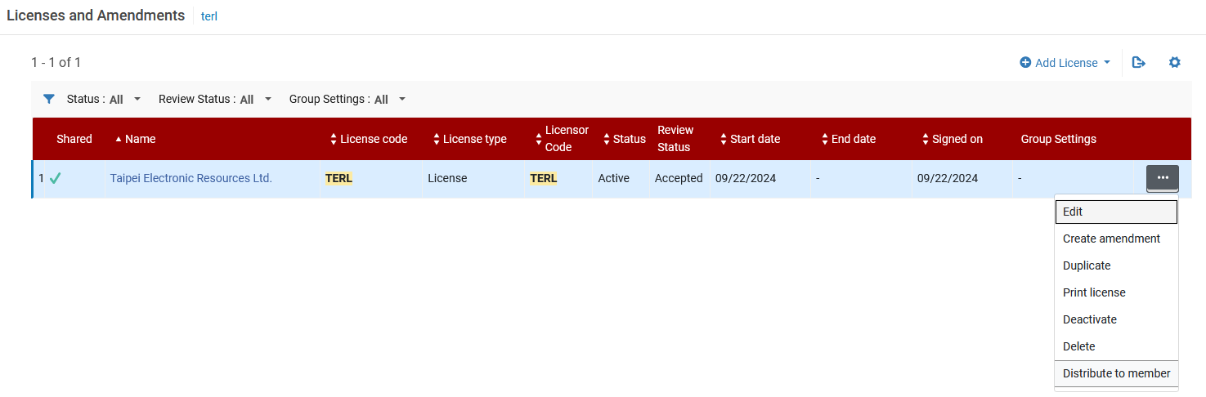
Distributing the shared license to Member Institutions
Select Distribute to member in the row actions list.

Slide 19
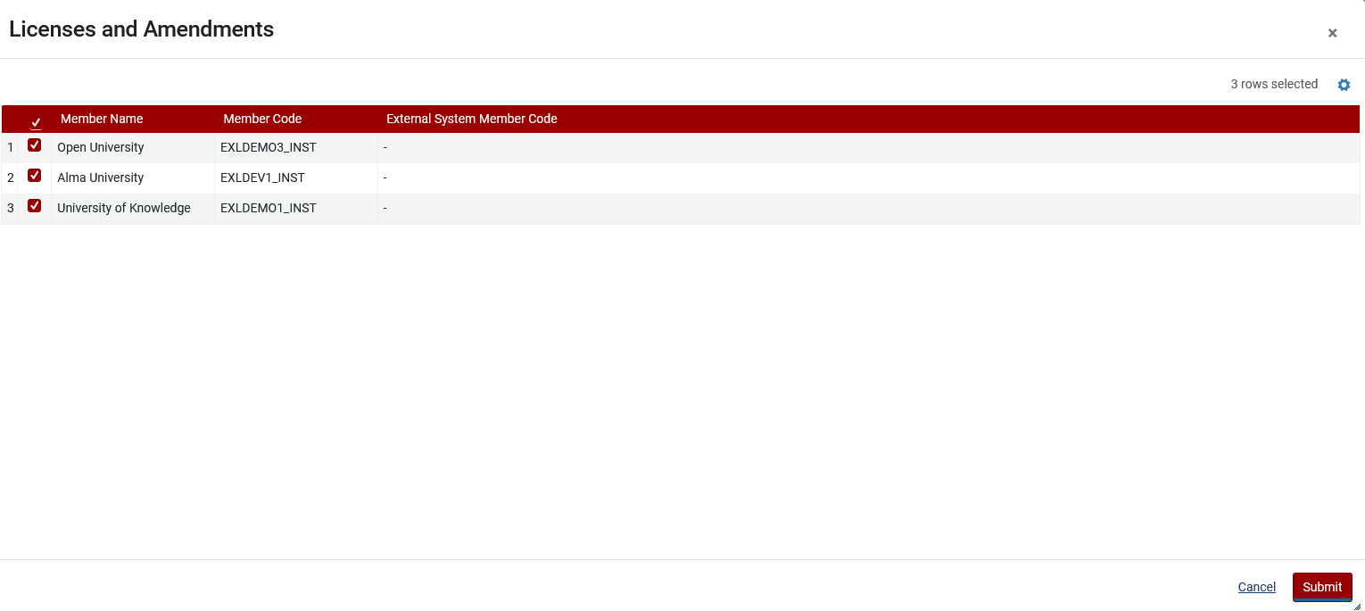
Distributing the shared license to Member Institutions
Select the members to which the license should be distributed.
Select Submit.

Slide 20
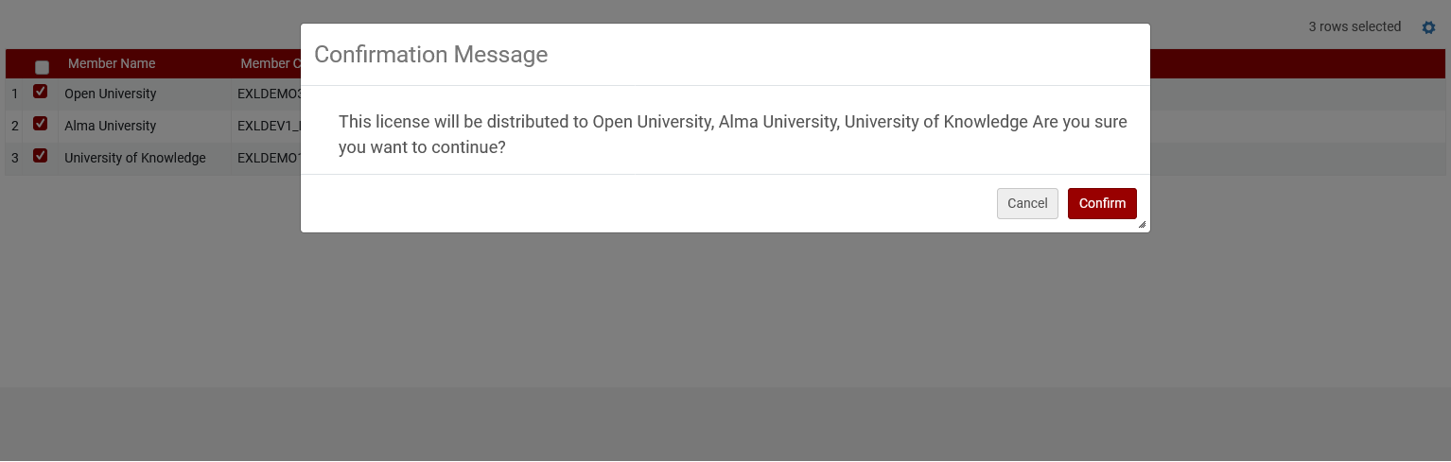
Distributing the shared license to Member Institutions
Select Confirm in the confirmation dialog box.

Slide 21
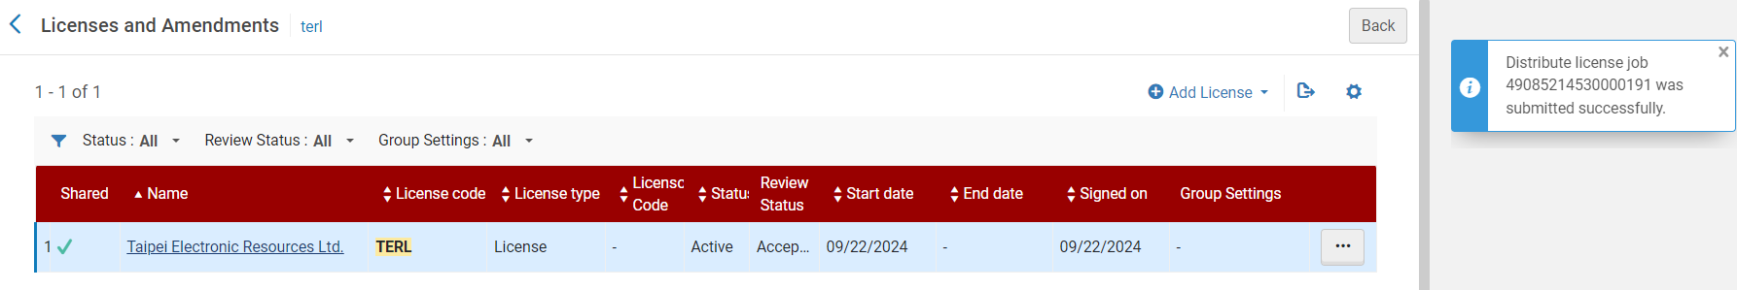
Distributing the shared license to Member Institutions
The “Distribute license job” runs.

Slide 22
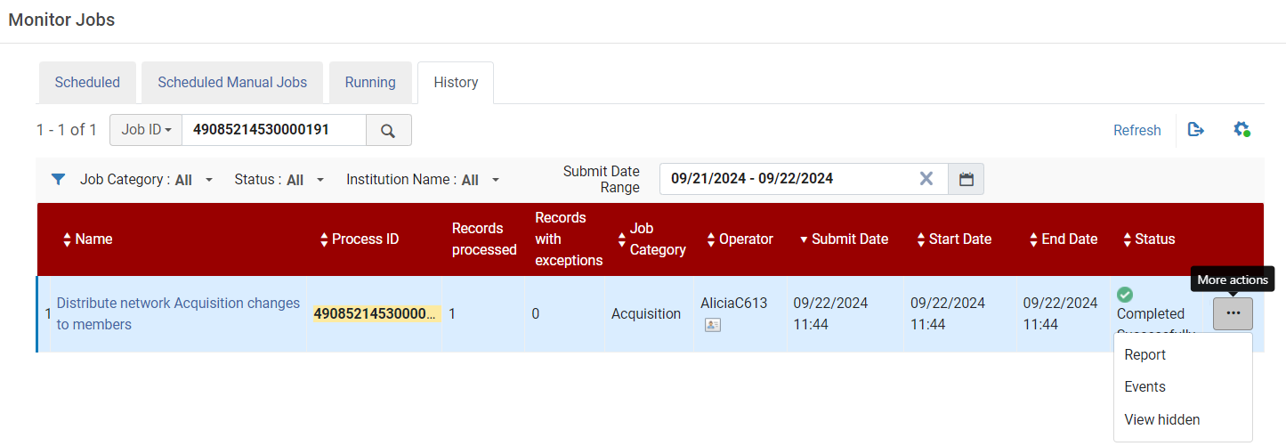
Distributing the shared license to Member Institutions
Here in “Monitor Jobs we see that “Distribute network Acquisition changes to members” has run. This includes the “Distribute license job” which we ran manually.
Let’s view the report

Slide 23
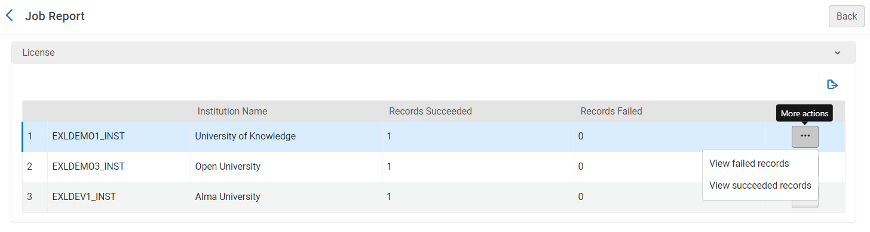
Distributing the shared license to Member Institutions
Now we will see what happened in the job.
Let’s view the succeeded records for Member Institution “University of Knowledge”

Slide 24
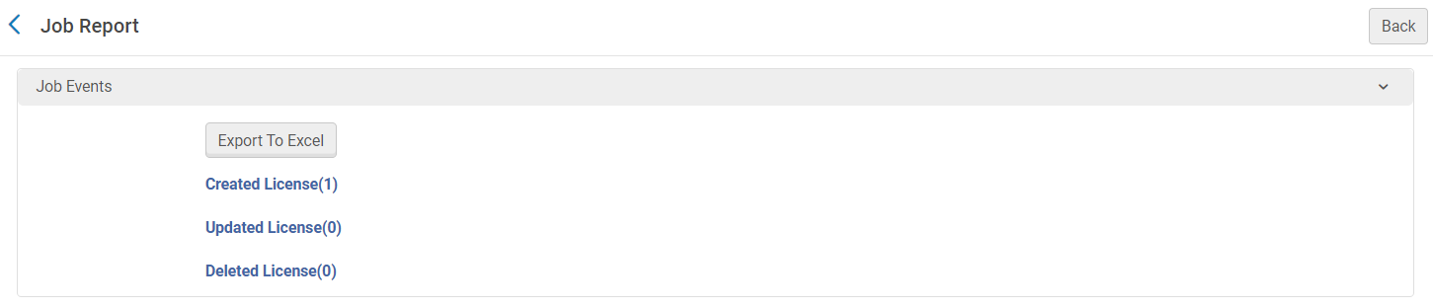
Distributing the shared license to Member Institutions
We see that the job created one license
We will click here

Slide 25
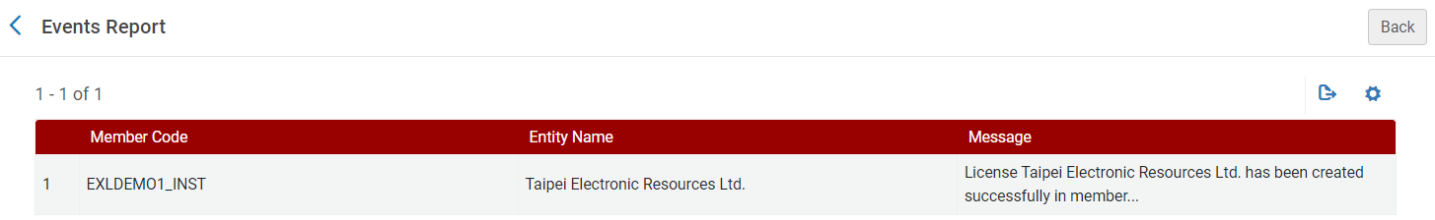
Distributing the shared license to Member Institutions
We see from the job that the license “Taipei Electronic Resources Ltd.” was created in the member institutions.

Slide 26
Viewing the shared license in the Member Institution

Slide 27
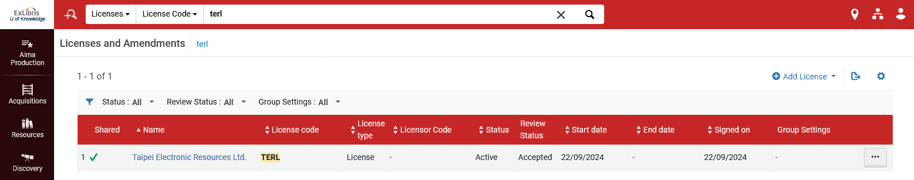
Viewing the shared license in the Member Institution
Here is the shared license “Taipei Electronic Resources Ltd.” in Member Institution “University of Knowledge”
The license is shared
We are in Member Institution “University of Knowledge”

Slide 28
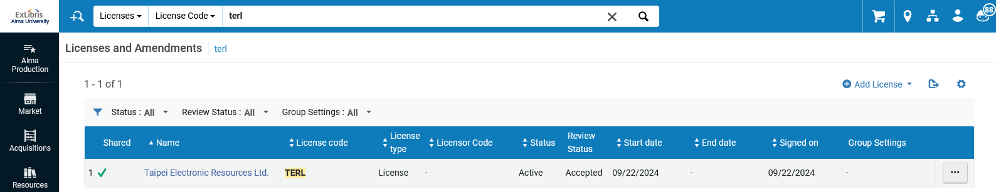
Viewing the shared license in the Member Institution
Here is the shared license “Taipei Electronic Resources Ltd.” in Member Institution “Alma University”
The license is shared
We are in Member Institution “Alma University”

Slide 29
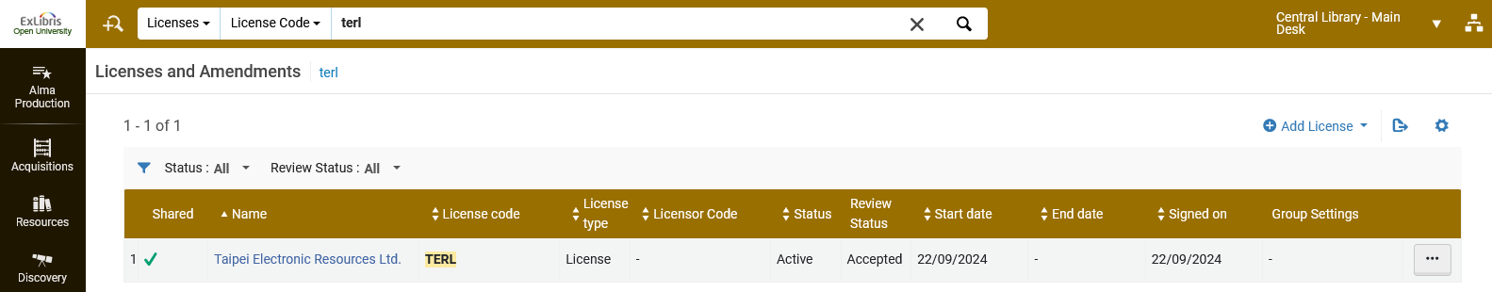
Viewing the shared license in the Member Institution
Here is the shared license “Taipei Electronic Resources Ltd.” in Member Institution “Open University”
The license is shared
We are in Member Institution “University of Knowledge”

Slide 30
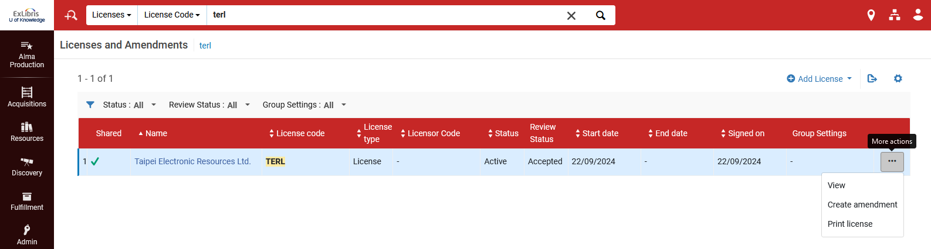
Viewing the shared license in the Member Institution
Because this is a shared license from the Network Zone in the Member Institution it can be viewed but not edited.

Slide 31
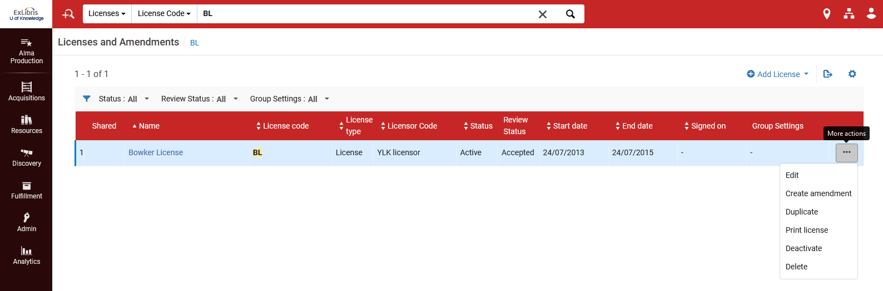
Viewing the shared license in the Member Institution
Licenses which are not shared can be edited (but shared licenses cannot be edited in the Member Institution)
This license is not shared, and thus can be edited

Slide 32
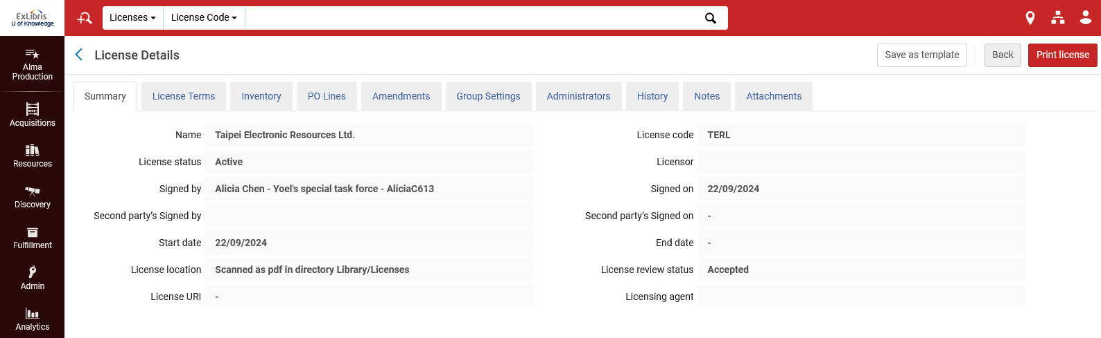
Viewing the shared license in the Member Institution
Here is the Summary tab of the shared license in the Member Institution “University of Knowledge” (all fields are greyed out because they cannot be edited)
Here is the shared license in the Member Institution. This is the same data as we saw for this license in the Network Zone institution.

Slide 33
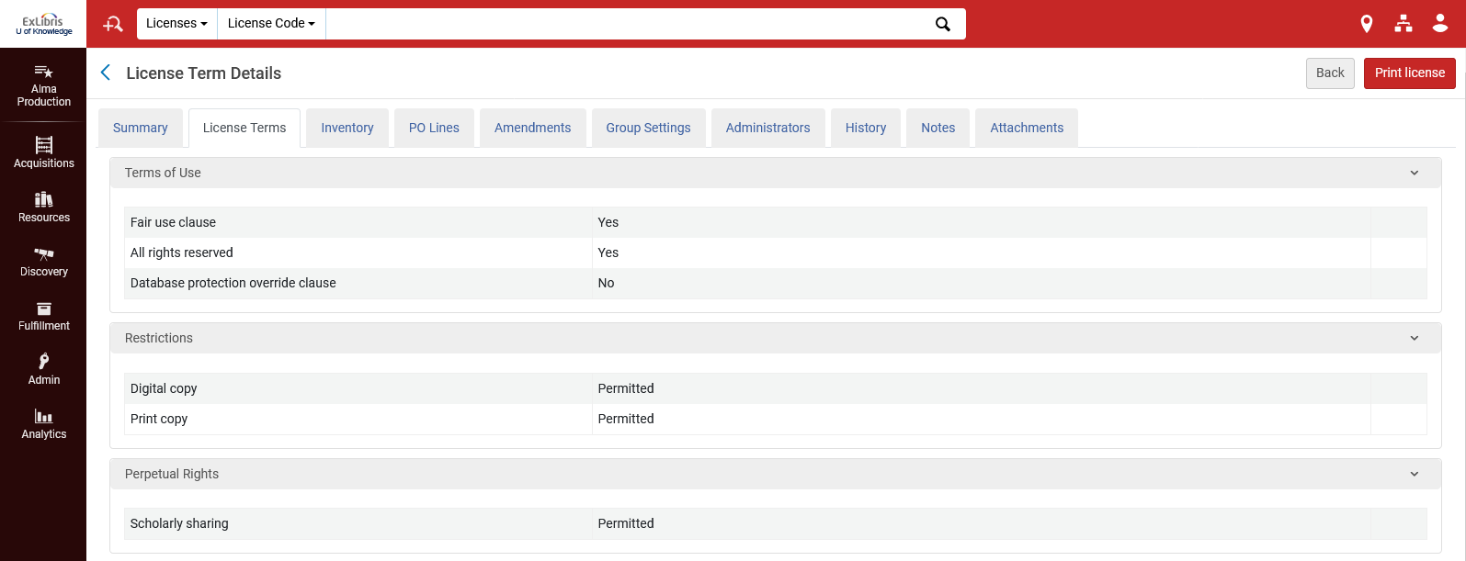
Viewing the shared license in the Member Institution
Here is the License Terms tab of the shared license in the Member Institution “University of Knowledge” (all fields are greyed out because they cannot be edited)
This is the same data as we saw for this license in the Network Zone institution.

Slide 34
Automatically distributing the shared license to Member Institutions

Slide 35
Automatically distributing the shared license to Member Institutions
In order to be able to distribute the licenses automatically (not manually as we previously did) via the job “Distribute network Acquisition changes to members”, the acq_distribution_job parameter must be set to “true”
This is accessed at “Configuration > Acquisitions > General > Other Settings”

Slide 36
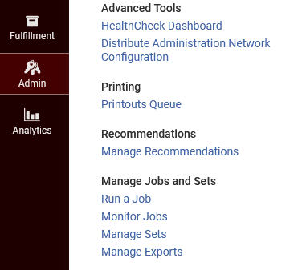
Automatically distributing the shared license to Member Institutions
When the acq_distribution_job parameter is set to “true” the job “Distribute network Acquisition changes to members” will be active and run daily.
This can be seen at “Admin > Manage Jobs and Sets > Monitor Jobs”

Slide 37
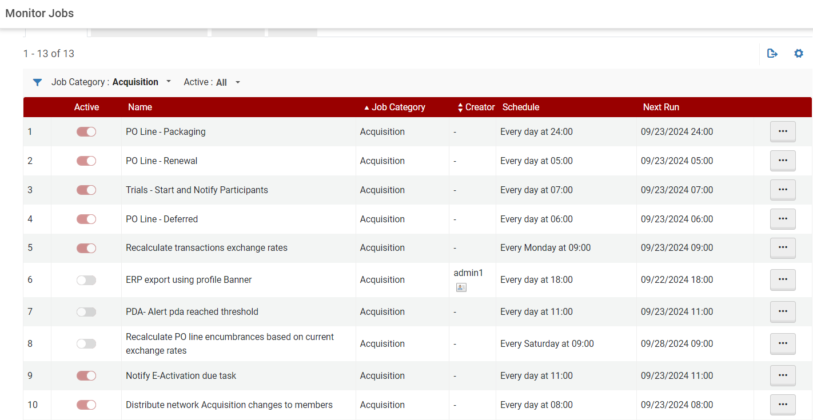
Automatically distributing the shared license to Member Institutions

Slide 38
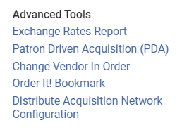
Automatically distributing the shared license to Member Institutions
Note that this job can also be run manually in the NZ (in addition to being scheduled) at “Acquisitions > Advanced Tools > Distribute Acquisition Network Configuration.”

Slide 39
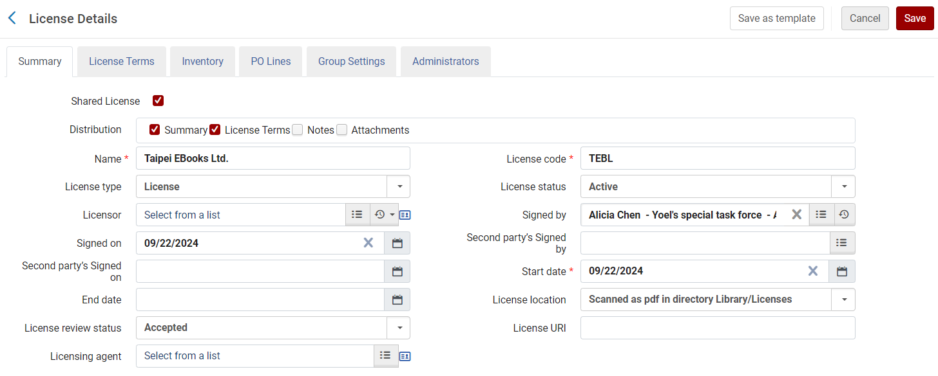
Automatically distributing the shared license to Member Institutions
Now we have another new shared license in the network Zone.
It is named “Taipei Ebooks Ltd.”

Slide 40
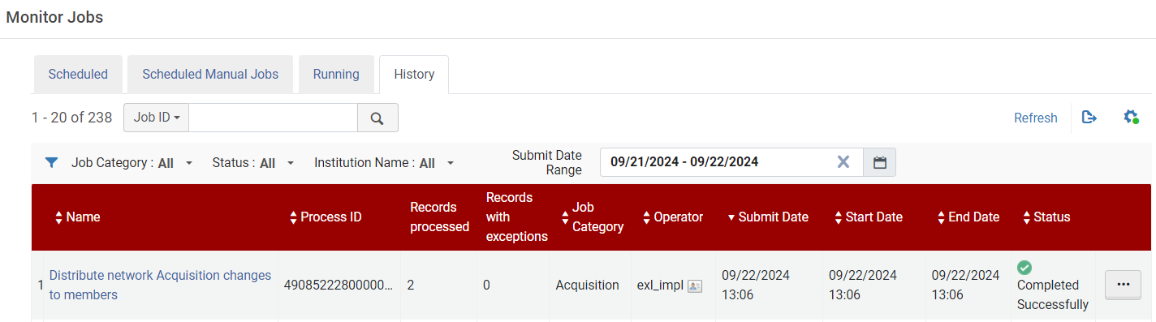
Automatically distributing the shared license to Member Institutions
The scheduled job “Distribute network Acquisition changes to members” has run and completed. The job ran without us manually clicking “Distribute to member” from the action items of the license.

Slide 41
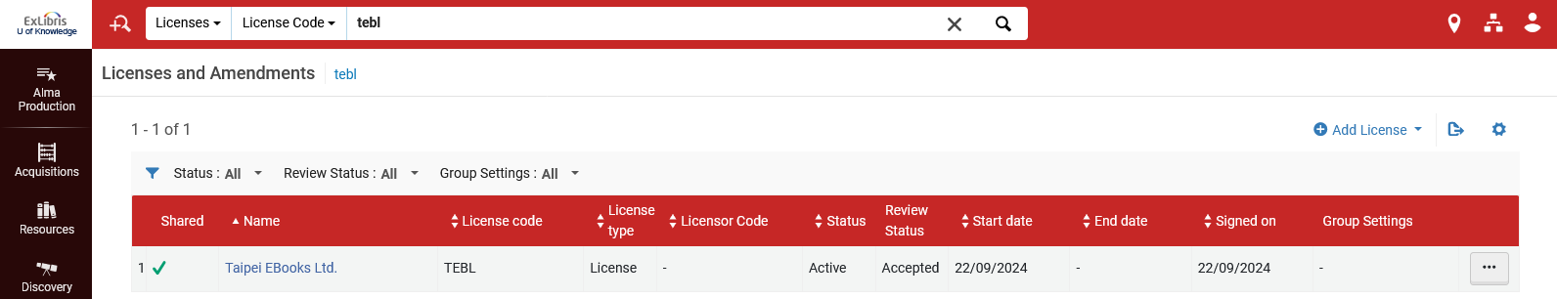
Automatically distributing the shared license to Member Institutions
The new shared license from the Network Zone has been created in Member Institution University of Knowledge
The license is shared
We are in Member Institution “University of Knowledge”

Slide 42
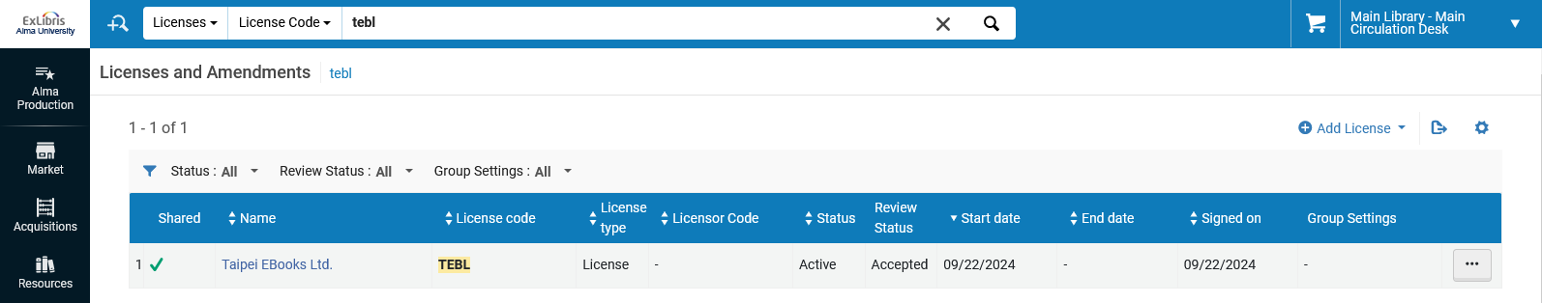
Automatically distributing the shared license to Member Institutions
The new shared license from the Network Zone has also been created in Member Institution Alma University
The license is shared
We are in Member Institution “Alma University”

Slide 43
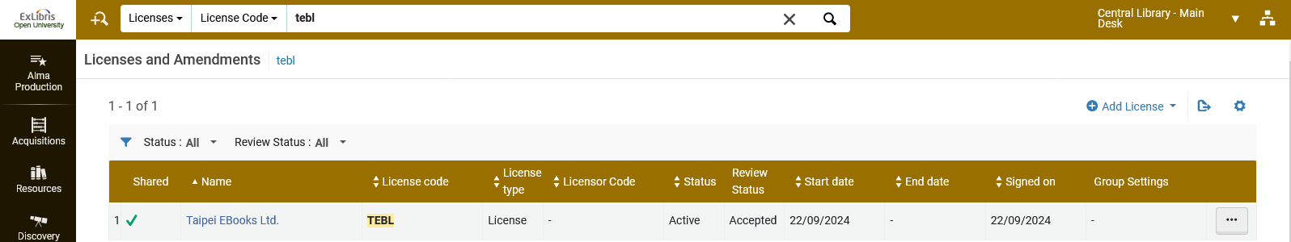
Automatically distributing the shared license to Member Institutions
The new shared license from the Network Zone has also been created in Member Institution Open University
The license is shared
We are in Member Institution “Open University”

